Slide 1
UNIT I
FUNDAMENTALS OF CONVENTIONAL SURVEYING AND LEVELLING

Slide 2
INTRODUCTION TO SURVEYING
Introduction: Definition, classification of surveys, Principles of surveying, Plan and map, Scale.
Chain surveying: Ranging and Chaining, survey station and survey lines, instruments used for setting out right angles, obstacles in chaining, Errors in chain survey.

Slide 3
One of the basic objective of surveying is to prepare plans and maps.
Plan
A plan is the graphical representation to some scale, of the features on, near or below the surface of the earth as projected on a horizontal plane.
The horizontal plane is represented by plane of drawing sheets on which the plan is drawn to some scale However the surface of the earth is curved it cannot be truly represented on a plane without distortion.
In plane surveying the area involved are small, the earth's surface may be considered as plane and hence plan is constructed by orthographic projections.
A plan is drawn on a relatively large scale

Slide 4
Map
If the scale of the graphical projection on a horizontal plane is small, the plan is called a map.
Thus graphical representation is called a plan if the scale is large while it is called a map if the scale is small.
On plan, generally only horizontal distances and directions or angles are shown.
On topographical map, however the vertical distances (elevations) are also represented by contour lines.

Slide 5
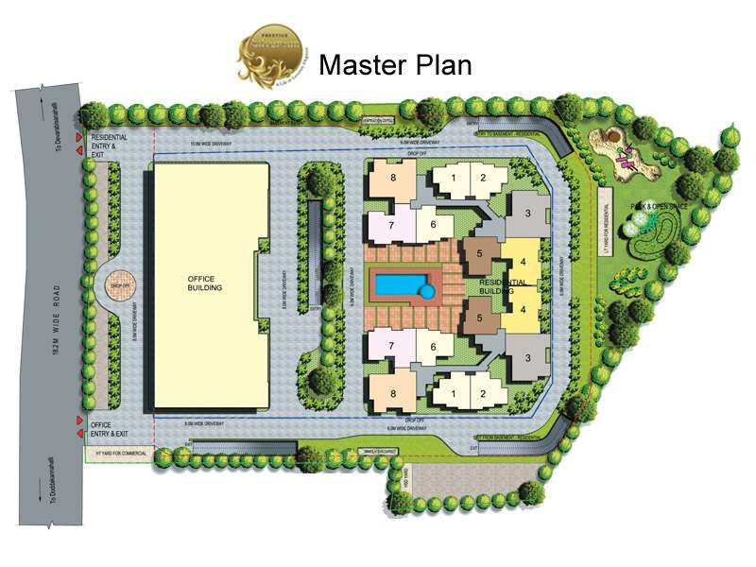
Plan

Slide 6
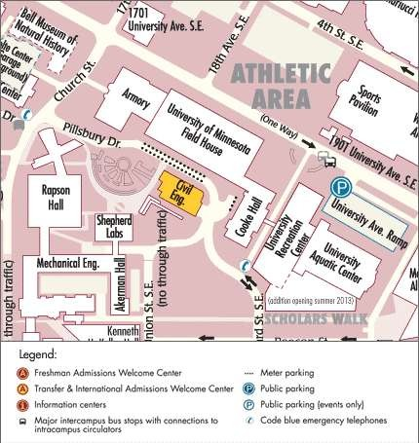
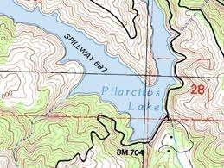
Map

Slide 7
Classification
Classification based on Nature of field
Land Survey
Land Survey is done on land to prepare plan and maps of a given area. Topographical, city and cadastral surveys are some of the examples of land surveying.
Hydrological Surveying
This survey is conducted on or near the body of water such as lake, river, coastal area. This Survey consists of locating shore lines of water bodies.

Slide 8
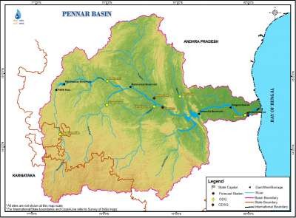
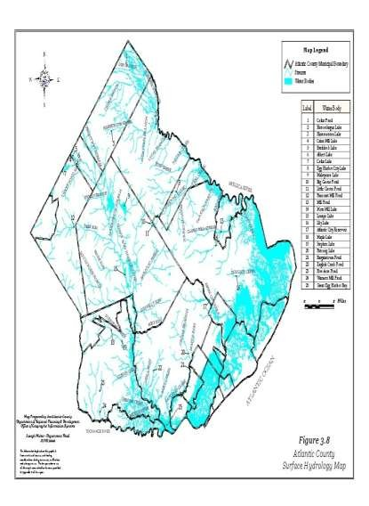
Hydrological Surveying

Slide 9
Classification of Surveying
Astronomical Survey
This survey is conducted for the determining of latitudes, longitudes, azimuths, local time, etc. for various places on earth by observing heavenly bodies ( sun or the stars).
Aerial Survey
An aerial survey is conducted from aircraft. Aerial cameras take photographs of the surface of the earth in overlapping strips of land. This is also known as photographic survey.

Slide 10
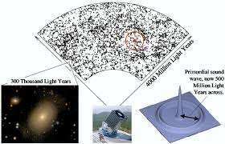
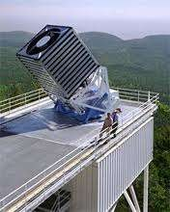
Astronomical Survey

Slide 11
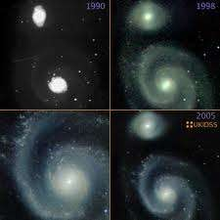
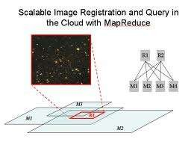
Astronomical Survey

Slide 12
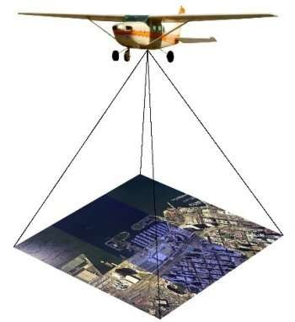
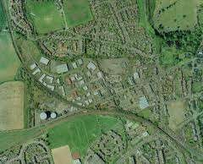
Aerial Survey

Slide 13
Uses of Surveying
The surveying may be used for following
purposes:
To prepare a topographical map which shows hills, valleys, rivers, forests, villages, towns etc.
To prepare a cadastral map which shows the boundaries of fields,plots,houses an other properties.
To prepare an engineering map which shows the position of engineering works such as buildings, roads, railways, dams, canals.

Slide 14
Uses of Surveying
To prepare a contour map to know the topography of the area to find out the best possible site for roads, railways, bridges, reservoirs, canals, etc.
Surveying is also used to prepare military map, geological map, archaeological map etc.
For setting out work and transferringdetails from the map on the ground.

Slide 15
Primary Divisions of Surveying
We know that the shape of earth is spheroidal,
thus the surface is obviously curved.
Surveying is primarily divided into two types considering the curvature of the earth's surface.
Plane Surveying
Geodetic Surveying

Slide 16
Primary Divisions of Surveying
Plain Surveying
The plain surveying is that type of surveying in which earth surface is considered as a plane and the curvature of the earth is ignored.
In such surveying a line joining any two stations is considered to be straight.
The triangle formed by any three points is considered as a plane triangle, and the angles of the triangle are considered as plain angles.
Surveying is carried out for a small area of less than 250 km² .
It is carried out by local or state agencies like R & B department, Irrigation department, Railway department.

Slide 17
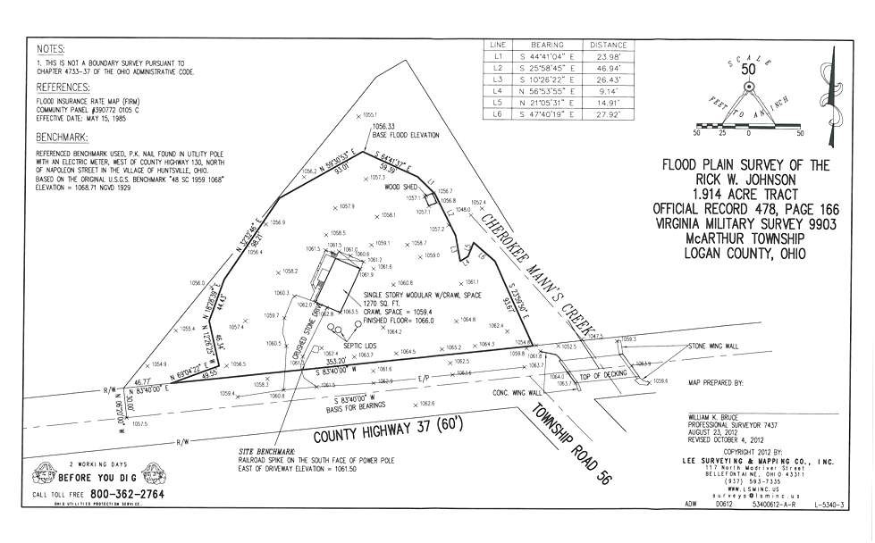
Plain Surveying

Slide 18
Geodetic Surveying
The geodetic Surveying is that type of surveying in which the curvature of the earth is taken into account.
It is generally extended over larger areas. The line joining any two stations is considered as curved line.
The triangle formed by any three points is considered to be spherical and the angles of the triangle are considered to be spherical angles.
Geodetic surveying is conducted by the survey of India Department and is carried out for a larger area exceeding 250 km²

Slide 19
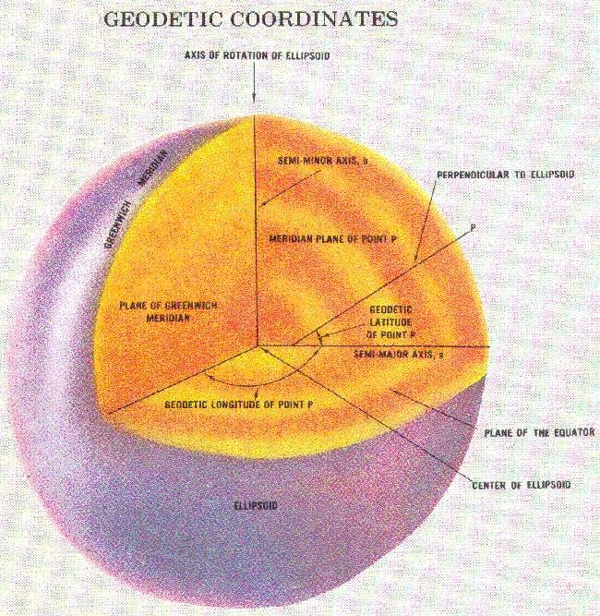
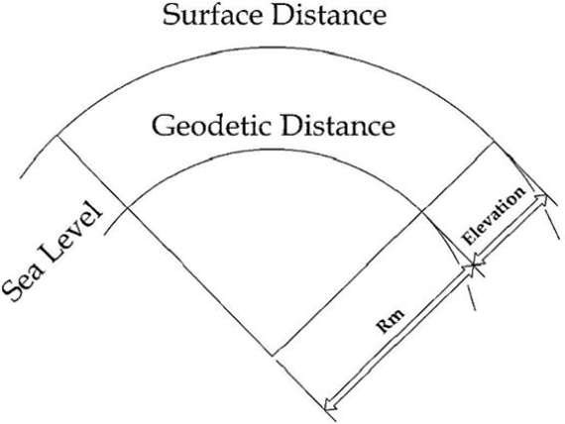
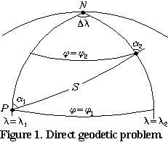

Slide 20
Plane Surveying Vs Geodetic Surveying
No. | Plane Surveying | Geodetic Surveying
1 | The earth surface is considered as plain Surface. | The earth surface is considered as Curved Surface.
2. | The Curvature of the earth is ignored | The curvature of earth is taken into account.
3 | Line joining any two stations is considered to be straight | The line joining any two stations is considered as spherical.
4. | The triangle formed by any three points is considered as plain | The Triangle formed by any three points is considered as spherical.
5. | The angles of triangle are considered as plain angles. | The angles of the triangle are considered as spherical angles.
6. | Carried out for a small area < 250 km² | Carried out for a small area > 250 km²

Slide 21
Classification of Surveying
Survey can be classified into various categories depending on methods used and nature of the field.
Classification Based on Instruments.
Chain Survey:
This is the simplest type of surveying in which only linear measurements are made with a chain or a tape. Angular measurements are not taken.

Slide 22
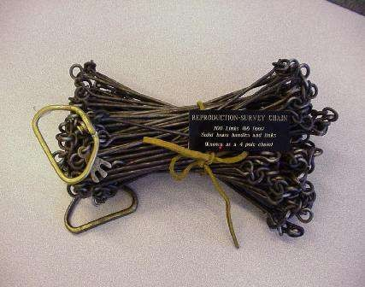
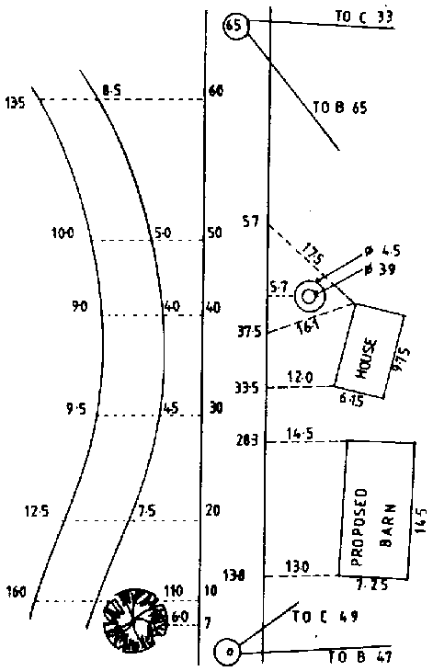
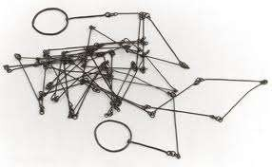

Slide 23
Compass Survey:
In Compass Survey, the angles are measured with the help of a magnetic compass.
Chain and compass survey:
In this survey linear measurements are made with a chain or a tape and angular measurements with a compass.

Slide 24
Plane Table Surveying
It is a graphical method of surveying in which field works and plotting both are done simultaneously.
Theodolite Survey:
In theodolite survey the horizontal angles are measured with the theodolite more precisely than compass and the linear measurements are made with a chain or tape.

Slide 25
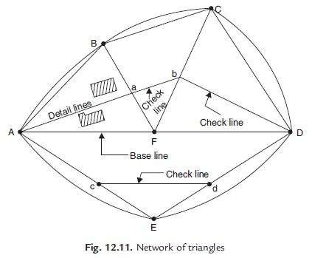
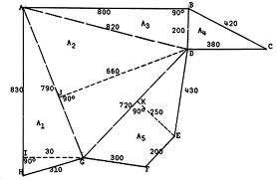
Triangulation

Slide 26
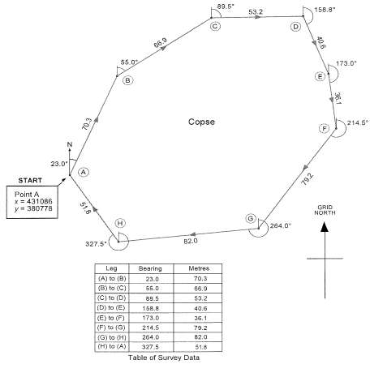
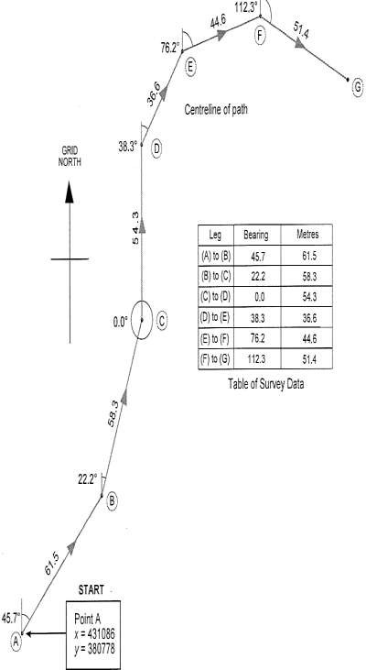
Traversing

Slide 27
Classification based on Purpose
Geological Survey:
In this both surface and subsurface surveying are conducted to locate different minerals and rocks. In addition, geological features of the terrain such as folds and faults are located.

Slide 28
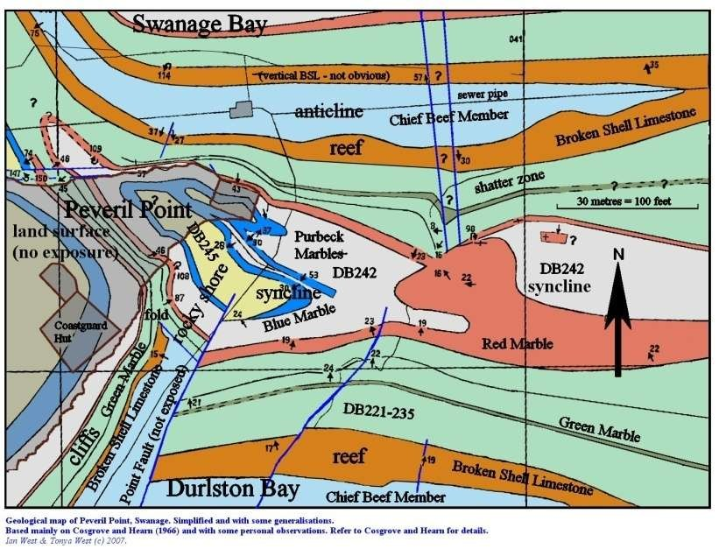

Slide 29
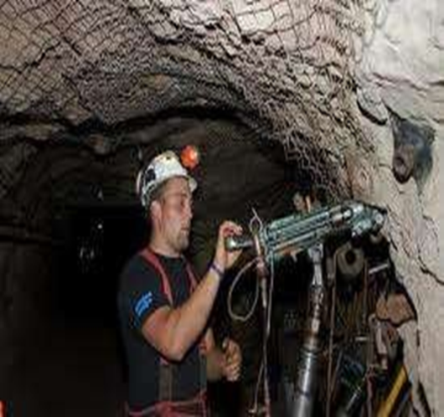
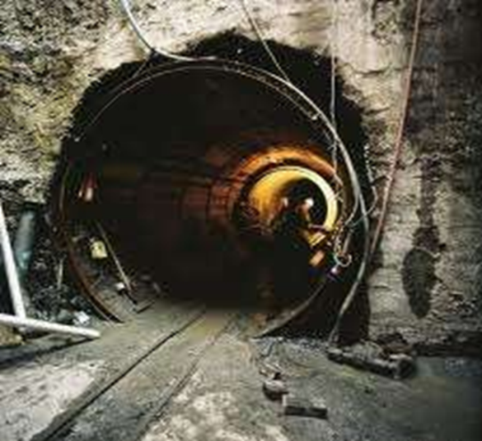
Mine Survey
Mine Survey includes include both surface and underground surveys. It is conducted for the exploration of mineral deposits and to guide tunneling and other operations associated with mining.

Slide 30
Archaeological Survey
It is conducted to locate relics of antiquity, civilization, kingdoms, forts, temples, etc.
Military Survey
It has a very important and critical applications in the military. Aerial surveys are conducted for this purpose. It is conducted to locate strategic positions for the purpose of army operations.

Slide 31
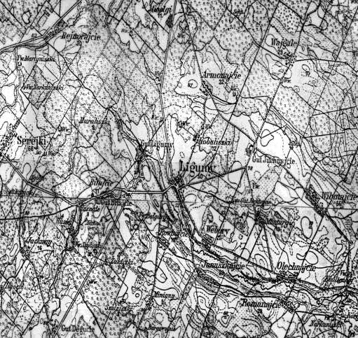
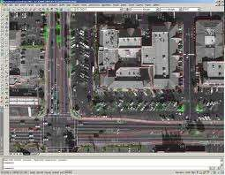
Military Survey

Slide 32
What is Levelling?
The art of determining relative altitudes of points on surface of earth r beneath surface of earth is called levelling.
This is branch of surveying which deals with measurement in vertical planes only.
For execution of any engineering project like highways, railways, canals, dams, building, water supply and sanitary scheme it is very necessary to determine elevations of different points along the alignments of proposed projects.

Slide 33
Levelling is employed to provide accurate network of heights, covering entire area of project.
Levelling is of prime importance to the engineers, both in acquiring necessary data for design of project and also during its execution.
Principle of Levelling The principle of levelling is to obtain horizontal line of sight with respect to which vertical distances of the points above or below this line of sight are found.

Slide 34
Objects of levelling
Levelling is done for following purposes.
To prepare a contour map for fixing sites for reservoirs, dams, barrages etc, and to fix alignment of roads, railways, irrigation canal etc.
To determine the altitudes of different important points on hill or to know reduce level of different points on surface , above or below surface of earth.
To prepare longitudinal section or cross section of projects in order to determine volume of earth work.
To prepare layout map for water supply , sanitary or drainage.

Slide 35
Uses of Levelling.
1. To establish bench mark as vertical control points which serve as references for other levelling.
  To enable surveyor calculate whether two points are intervisible from each other on the ground surface.
  To enable surveyor measurements to be reduced to the horizontal at sea level.
  To enable drainage works to be surveyed so that water way flow in the desired direction.
  To provide information for scientists about the shape and structure of the earth and its movement.

Slide 36
Terms used in leveling
(1)Level surface : A surface parallel to the mean spheroidal surface of the earth is called a level surface. Such surface is a curved surface. Water surface of still lake is considered as level surface.
The line drawn on the level surface is known as a level line. This line is normal to plumb line. Hence all points lying on a level surface are equidistant from the centre of the earth.
(2)Horizontal Surface: A surface tangential to level surface at a given point is called horizontal surface at that point. Hence a horizontal line is at right angles to the plumb line at that point, which indicates direction of gravity

Slide 37
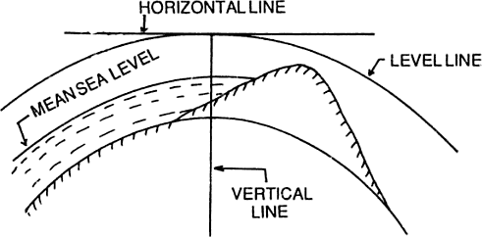

Slide 38
Thank You

