Slide 1
UNIT II
THEODOLITE AND TACHEOMETRIC SURVEYING

Slide 2
THEODOLITE SURVEYING
Theodolite Survey: Types of theodolite ,Parts of thedolite,Definitions, Measurement of horizontal and vertical angle, Tacheometric surveying- Stadia and tangential methods - setting out of simple curves.

Slide 3
INTRODUCTION:
So far we have been measuring horizontal angles by using a Compass with respect to meridian, which is less accurate and also it is not possible to measure vertical angles with a Compass.
So when the objects are at a considerable distance or situated at a considerable elevation or depression ,it becomes necessary to measure horizontal and vertical angles more precisely. So these measurements are taken by an instrument known as a theodolite.

Slide 4
The system of surveying in which the angles are with the help of a theodolite, is called Theodolite surveying.

Slide 5
CLASSIFICATION OF THEODOLITES
Theodolites may be classified as ;
A.BASE ON HORIZONTAL AXIS
i) Transit Theodolite.
ii) Non Transit Theodolite.
B.BASE ON ANGLE
i) Vernier Theodolites.
ii) Micrometer Theodolites.
iii)Electronic digital theodolite.

Slide 6
CLASSIFICATION OF THEODOLITES
A. Transit Theodolite: A theodolite is called a transit
theodolite when its telescope can be transited i.e
revolved through a complete revolution about its
horizontal axis in the vertical plane, whereas in a-
Non-Transit type: the telescope cannot be
transited. They are inferior in utility and have now
become obsolete.

Slide 7
B.(a)Vernier Theodolite: For reading the graduated
circle if Vernier are used ,the theodolite is called as a
Vernier Theodolite
(b) Whereas, if a micro meter is provided to read the
graduated circle the same is called as a Micro meter
Theodolite.
( c )reading directly providing as digital num. if
electronic distance measuring is attached with it then
it’s call total station
Vernier type theodolites are commonly used

Slide 8
SIZE OF THEODOLITE
A theodolite is designated by diameter of the
graduated circle on the lower plate.
The common sizes are 8cm to 12 cm while 14 cm to
25 cm instrument are used for triangulation work.
Greater accuracy is achieved with larger
theodolites as they have bigger graduated circle with
larger divisions hence used where the survey works
It require high degree of accuracy.

Slide 9
USES OF THEODOLITE
The Theodolite is a most accurate surveying instrument mainly used for :
• Measuring horizontal and vertical angles.
• Locating points on a line.
• Prolonging survey lines.
• Finding difference of level.
• Setting out grades
• Ranging curves
• Tacheometric Survey

Slide 10
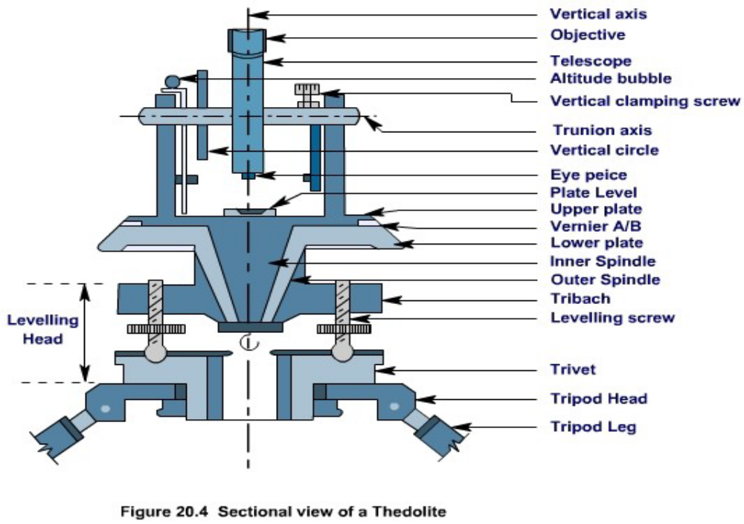

Slide 11
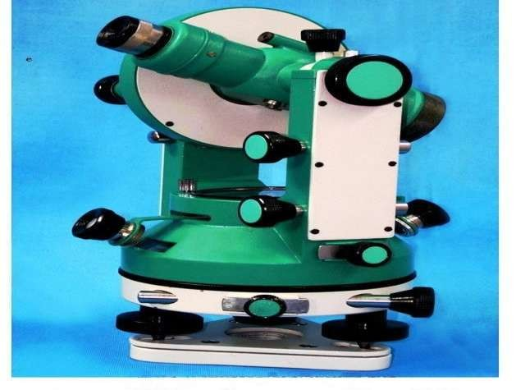
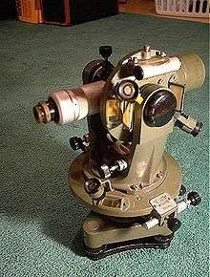

Slide 12
Centring
The setting of a theodolite exactly over a station mark by means of a plumb bob. Is known as centering.
Transiting
The method of turning the telescope about its horizontal axis in a vertical plane through 180 ⁰ is termed as transiting. In other words transiting results in a change in face.
Face left
“Face left” means that the vertical circle of the theodolite is on the left of the observer at the time of taking reading.

Slide 13
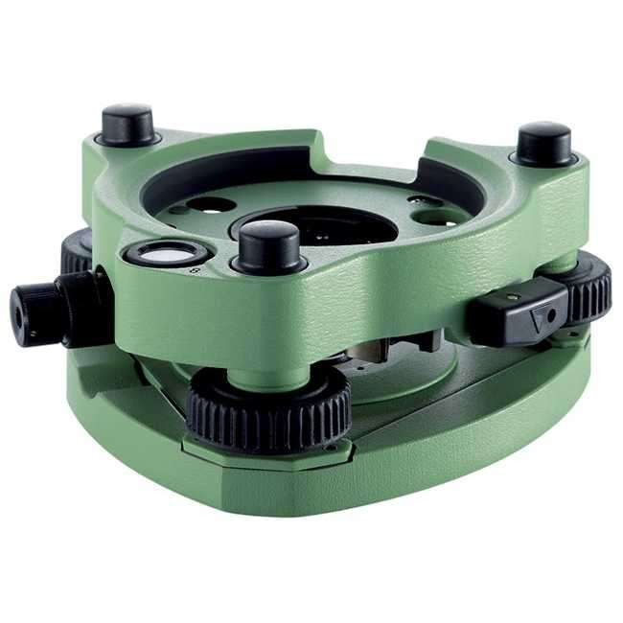
Optical Plummet

Slide 14
Face right
This refers to the situation when the vertical circle of the instrument is on the right of the observer when the reading is taken
Changing face
The operation of bringing the vertical circle from one side of the observer to the other is known as changing face.
Swinging the telescope
This indicates turning the telescope in a horizontal plane. It is called „right swing‟ when the telescope is turned clockwise and „left swing‟ when the telescope is turned anticlockwise.

Slide 15


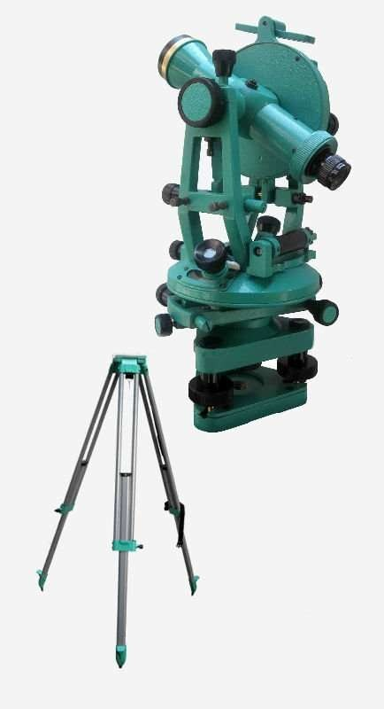

The Transit Theodolite

Slide 16
Line of Collimation
It is an imaginary line passing through optical centre of the objective glass and its continuation.
Axis of Telescope
The axis is an imaginary line passing through the optical centre of the object glass and the optical centre of the eye-peace.
Axis of the Bubble Tube
It is an imaginary line tangential to the longitudinal curve of the bubble tube at its middle point.

Slide 17
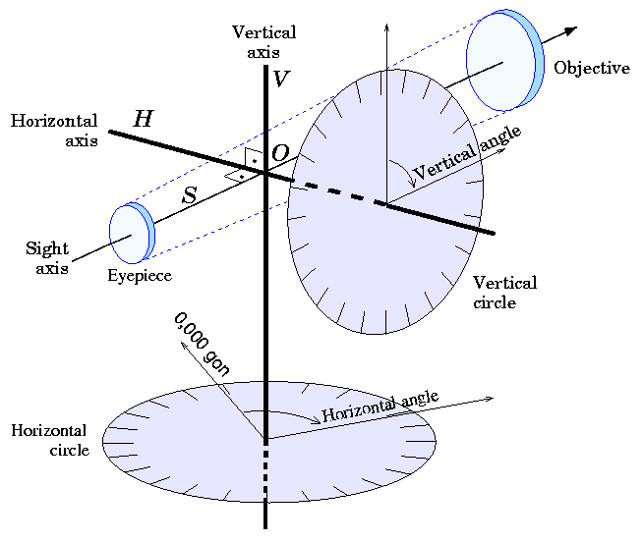
Axis of Theodolite

Slide 18
Vertical Axis
it is the axis of rotation of the telescope in the horizontal plane
Horizontal Axis
It is the axis of rotation of the telescope in the vertical
plane.
Temporary Adjustment
The setting if the theodolite over a station at the time of taking any observation is called temporary
adjustment.
Permanent Adjustment
When the desired relationship between the fundamental
lines of a theodolite is disturbed, then some procedures
are adopted to establish this relationship. This
adjustment is known as permanent adjustment.

Slide 19
Least Count of the vernier
This is the difference between the value of the smallest division of the main scale and that of the smallest division of the vernier scale. It is the smallest value that can be measured by a theodolite.
V= d
n
Where, v= Value of smallest division of vernier Scale d= Value of the smallest division of main scale n= no of small divisions on vernier scale.
Least count of theodolites are generally 20” and 15” and so on.

Slide 20
The Diaphragm
The diaphragm is a brass ring consisting of cross-hairs, or one containing a glass disc with fine lines engraved on it.
It is placed in position by turning four capstan-headed screws, and can be moved up, down or sideways when required.
It is fixed in front of the eye-piece.
The cross- hairs may be made of fine platinum wire.

Slide 21
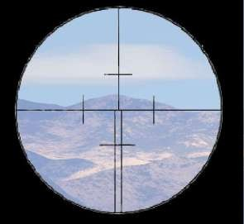
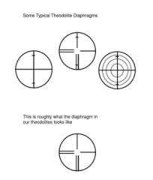

Slide 22
Trivet
It is a circular plate having a central, threaded hole for fixing the theodolite on the tripod stand by a wing nut. It is also called the base plate. Three foot screws are secured to this plate by means of a ball and socket arrangement.
And the upper threaded part passes through the threaded hole in the tribrach plate.

Slide 23
Thank You

