Slide 1
UNIT III
CONTROL SURVEYING AND ADJUSTMENT

Slide 2
Temporary Adjustment of Level
Selection of suitable position
Fixing level with tripod stand
Approximate levelling by legs of tripod stand
Perfect levelling by foot screws
Focussing the eye-piece
Focussing the object glass
Taking the staff readings

Slide 3
Selection of suitable position - A sutaible position is selected for setting the level . From this position , it should be possible to take the greatest number of observation without difficulty.
Fixing level with tripod stand – the tripod stand is placed at the required position with its legs well apart, and pressed firmly into the ground. The level is fixed on the tripod stand according to the fixing arrangement provided.

Slide 4
Approximate levelling by legs of tripod stand- the foot screws are brought to the center of their run. Two legs of the tripod stand are firmly fixed into the ground. Then the third leg is moved to the left or right , in or until the bubble is approximately at the centre of its run.

Slide 5
Perfect levelling by foot screws – longitudinal bubble on the top of the telescope.
Bubble brought to the center by turning the foot screw equally either both inward or outward.
Then telescope turned through 90 degree. And brought over the third foot screw , and the bubble is brought to the center by turning this foot screw clockwise and anticlockwise.
The telescope again brought to its original position. And bubble to the centered the process repeated several times until bubble remain its central position.

Slide 6
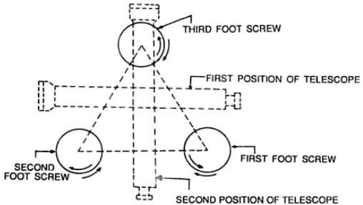

Slide 7
Focussing the eye-piece – a piece of white paper is held in front of the object glass and the eye piece is moved in or out by turning it clockwise or anticlockwise until the cross hairs can be seen clearly.
Focussing the object glass – telescope directed toward the levelling staff. Looking through the eye piece, the focusing screw is turned clockwise or antilock wise until the graduation of staff is visible.
Taking the staff readings- finally the leveling of the instrument is verified by turning the telescope in any direction. When the bubble remain in the central position for any direction of the telescope.

Slide 8
Setting
During Setting, the tripod stand is set up at a convenient height having its head horizontal (through eye estimation). The instrument is then fixed on the head by rotating the lower part of the instrument with right hand and holding firmly the upper part with left hand. Before fixing, the leveling screws are required to be brought in between the tribrach and trivet. The bull's eye bubble (circular bubble), if present, is then brought to the centre by adjusting the tripod legs.

Slide 9
Levelling
Step 1: The level tube is brought parallel to any two of the foot screws, by rotating the upper part of the instrument.
Step 2: The bubble is brought to the centre of the level tube by rotating both the foot screws either inward or outward. (The bubble moves in the same direction as the left thumb.)
Step 3: The level tube is then brought over the third foot screw again by rotating the upper part of the instrument.
Step 4: The bubble is then again brought to the centre of the level tube by rotating the third foot screw either inward or outward.
Step 5: Repeat Step 1 by rotating the upper part of the instrument in the same quadrant of the circle and then Step 2.
Step 6: Repeat Step 3 by rotating the upper part of the instrument in the same quadrant of the circle and then Step 4.
Step 7: Repeat Steps 5 and 6, till the bubble remains central in both the positions.
Step 8: By rotating the upper part of the instrument through 180 o , the level tube is brought parallel to first two foot screws in reverse order. The bubble will remain in the centre if the instrument is in permanent adjustment.

Slide 10
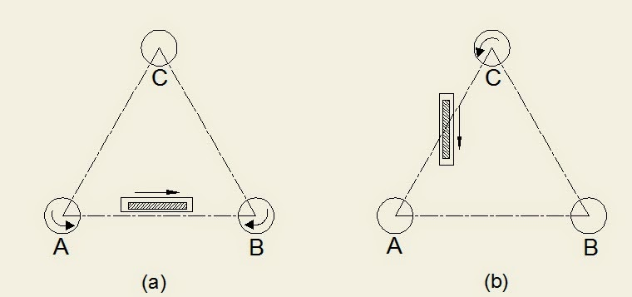

Slide 11
Focusing of eye piece
For focusing the eye-piece, the telescope is first pointed towards the sky. Then the ring of eye-piece is turned either in or out until the cross-hairs are seen sharp and distinct. Focusing of eye-piece depends on the vision of observer and thus required whenever there is a change in observer.

Slide 12
Focusing of object glass
For focusing the objective, the telescope is first pointed towards the object. Then, the focusing screw is turned until the image of the object appears clear and sharp and there is no relative movement between the image and the cross-hairs. This is required to be done before taking any observation.

Slide 13
Permanent adjustment of level
In a dumpy level, there are only two adjustments as he telescope is rigidly fixed to the spindle.
1. The axis of the bubble tube should be perpendicular to the vertical axis.
2. The line of collimation should be parallel to the axis of the bubble tube.

Slide 14
Sensitiveness of level tube
Sensitiveness of bubble tube is defined as the angular value of one division marked on the tube.
It is amount the horizontal axis has to be tilted to cause the bubble to move from one graduation to another.

Slide 15
A tube is said to be more sensitive if the bubbles moves by more divisions for a given change in the angles

Slide 16
The sensitiveness of a bubble tube can be increased by
Increasing the internal radius of the tube
Increasing the diameter of the tube
Increasing the length of the tube
Decreasing the roughness of the walls
Decreasing the viscosity of the liquid

Slide 17
8)BENCH MARK – (BM) – B.M. is a fixed reference point of known elevation with reference to datum line. They survey as reference points for finding RL of new points or for conducting levelling operations in project involving roads and railways.
It may be of the following types.
  GTS Bench mark (Great Trigonometrically Survey) :
These Bench marks are established by national agency
like Survey of Pakistan. They are established with highest precision at an interval of 100 km all over country . Their position and elevation above MSL is given in a special catalogue known as GTS Maps.

Slide 18
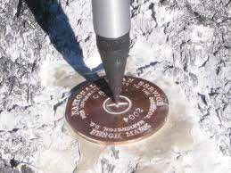
BM

Slide 19
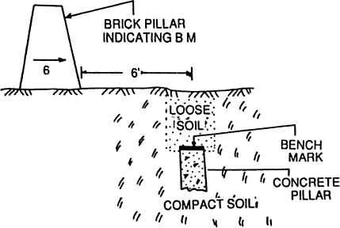
ii) Permanent Bench Mark : They are fixed points of reference establish with reference to GTS Bench mark by other government agencies like PWD , Railways, irrigation etc, and are kept on permanent points like culvert, kilometer stones, railway platforms, pillars etc.

Slide 20
iii) Arbitrary Bench mark : These are reference points whose elevations are arbitrarily assumed. These are adopted for small work, when only undulation of ground is important to be determined.
(iv) Temporary B.M: when the B.Ms are established temporarily at the end of day’s work, they are said to be temporary Bench Mark. They are generally made on root of tree, parapet of nearby culvert etc.

Slide 21
Thank You

